Slide 1


Machine Learning & Qualitative Analysis
Alex, Mayuresh, Rucha and Swati

Slide 2
Ratings and prices can form a great predictor in a qualitative market analysis.
Our project was to explore the potential of predicting success using these parameters from an author’s perspective.

Slide 3
All about Data
Amazon’s product data
Meta data including reviews, ratings, prices, description

Slide 4
Technologies used
Python Pandas
Python Matplotlib
Python Flask
HTML/CSS/Bootstrap
JavaScript Plotly
Javascript D3.js
Google Cloud SQL
Tableau

Slide 5
Data
Reached out to UCSD
Shrink the data via normalization process.
We experimented with feature set and predictor and finally decided to use feature set as category and price. The output variable was user ratings or acceptance.

Slide 6
Machine Learning Model
Models included - Random Forest Classifier and Deep Learning

Slide 7
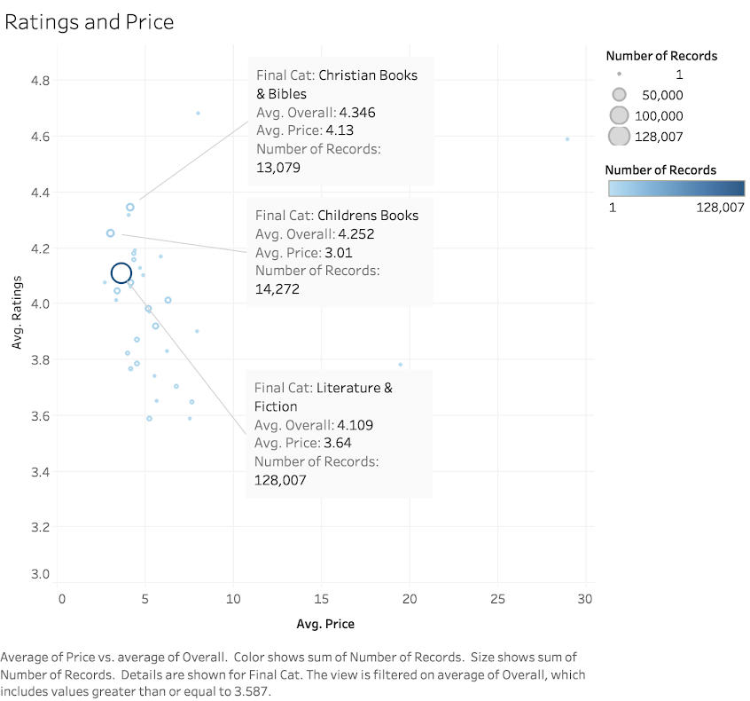
Tableau Analysis

Slide 8
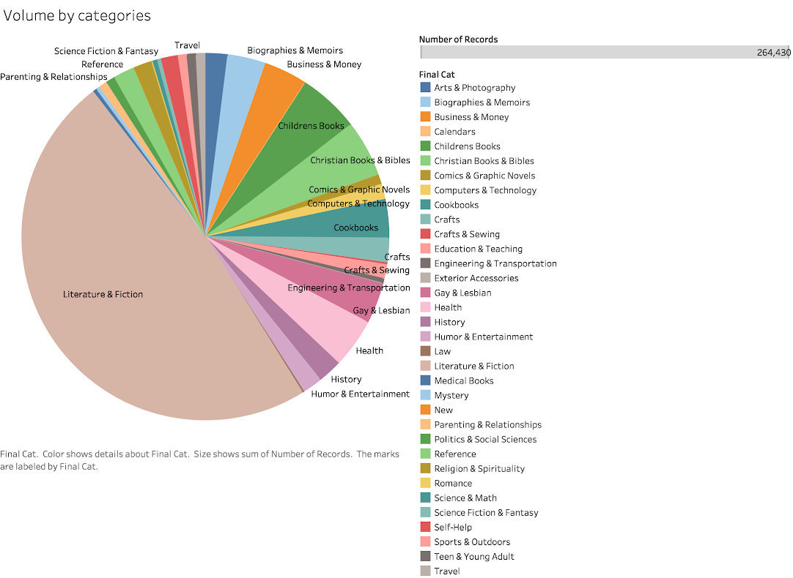

Slide 9
Conclusion
Visualization demonstrates concentration of high ratings in the lower price segment.
The learnings from one category – books, can be applied to other categories and help forming a pattern to help the seller determine the best price for their offerings.

